Slide 1
Airline Efficiency Analysis
Group – 2
Ajay Rama Raju Datla Z1979893
Ranjith Reddy Narra Z1979493

Slide 2
Agenda :
3-Minute Story
Big Idea
Data Collection Process & Data Source
Analysis Overview
Data Visualization and Dashboard
Conclusion and References

Slide 3
3 Minute Story:
This dataset provides a wealth of information about flights operated by American Airlines (AA), JetBlue Airways (B6), and Delta Air Lines (DL).
The data includes details on flight schedules, delays, and airport efficiency, with 31 columns and nearly 1,30,104 rows.
By analyzing this data, we can gain insights into flight delays, compare airline performance, identify busy airports, and assess ground efficiency.
Understanding the reasons behind delays and evaluating key performance metrics can help improve the overall travel experience for passengers and enhance operational efficiency for American Airline aviation.

Slide 4

Big Idea:
The main point to deliver to the Stake Holders of American Airlines is that this project will provide a comparative analysis of the types of delays experienced by passengers across different airlines, enabling American Airlines to identify specific areas for improvement that can enhance customer satisfaction and operational efficiency.

Slide 5
Source and Method of Data Collection:
Data Source: https://www.kaggle.com/
Data Set: Airline Delay and Cancellation Data, 2009 - 2018 (kaggle.com)
Industry: Aviation
Objective: Analyze airline and airport data with the aim of improving overall aviation industry effectiveness and passenger satisfaction.

Slide 6
Analysis Overview:
We aim to find out on how competitor airlines (JetBlue Airways (B6), and Delta Air Lines (DL)) operate when compared to American Airlines:
Delay Analysis: We examine factors causing delays, from weather to operational issues, to empower airlines with preemptive strategies for disruption mitigation.
Airport Performance: By scrutinizing delay patterns, we identify airports with consistent delays, paving the way for infrastructure improvements and operational optimizations.
Departure and Arrival Delays: Comparing average departure and arrival delays reveals operational nuances and prompts reevaluation of scheduling strategies.
Air-Time Performance: Examining average flight time versus distance for AA, B6, and DL determines if AA's routes prioritize quick travel. Analysis unveils route efficiency, aiding AA's strategy.
Weekly Airline performance: Analysing daily airline performance throughout the week to identify trends impacting delays and optimize operations.

Slide 7
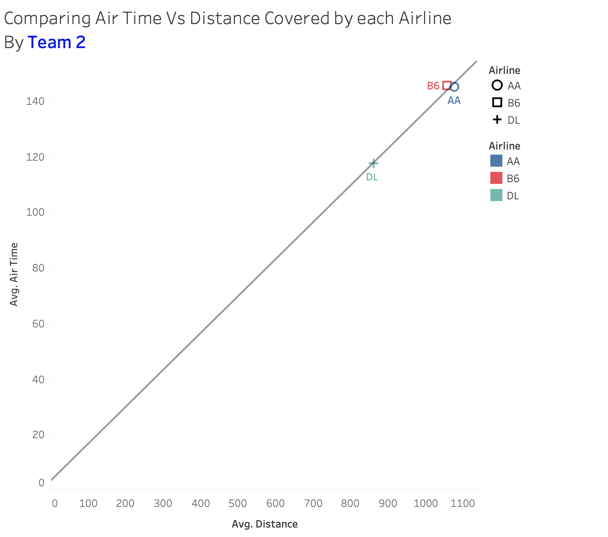
Chart 1: Air Time Vs Distance Covered By Each Airline:
Analysis: Each airline demonstrates consistent efficiency in airtime consumption relative to the distance travelled.

Slide 8
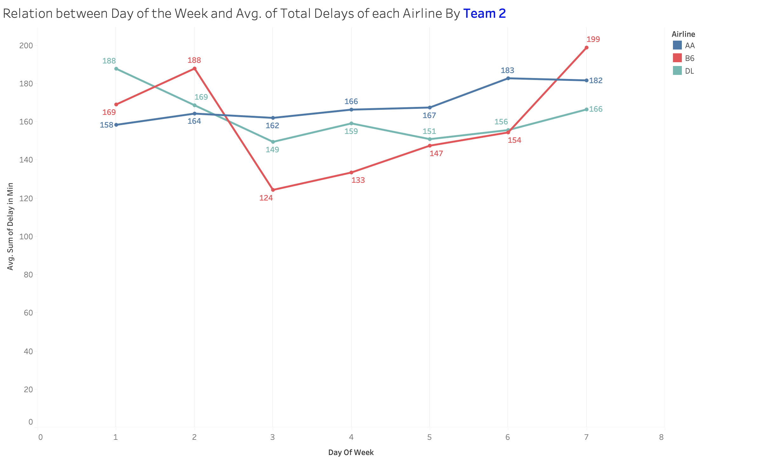
Chart 2: Relation between day of a week to total delays.
Analysis: AA maintains consistent performance compared to competitors (DL, B6) throughout the weekdays, with increased delays observed on weekends.

Slide 9
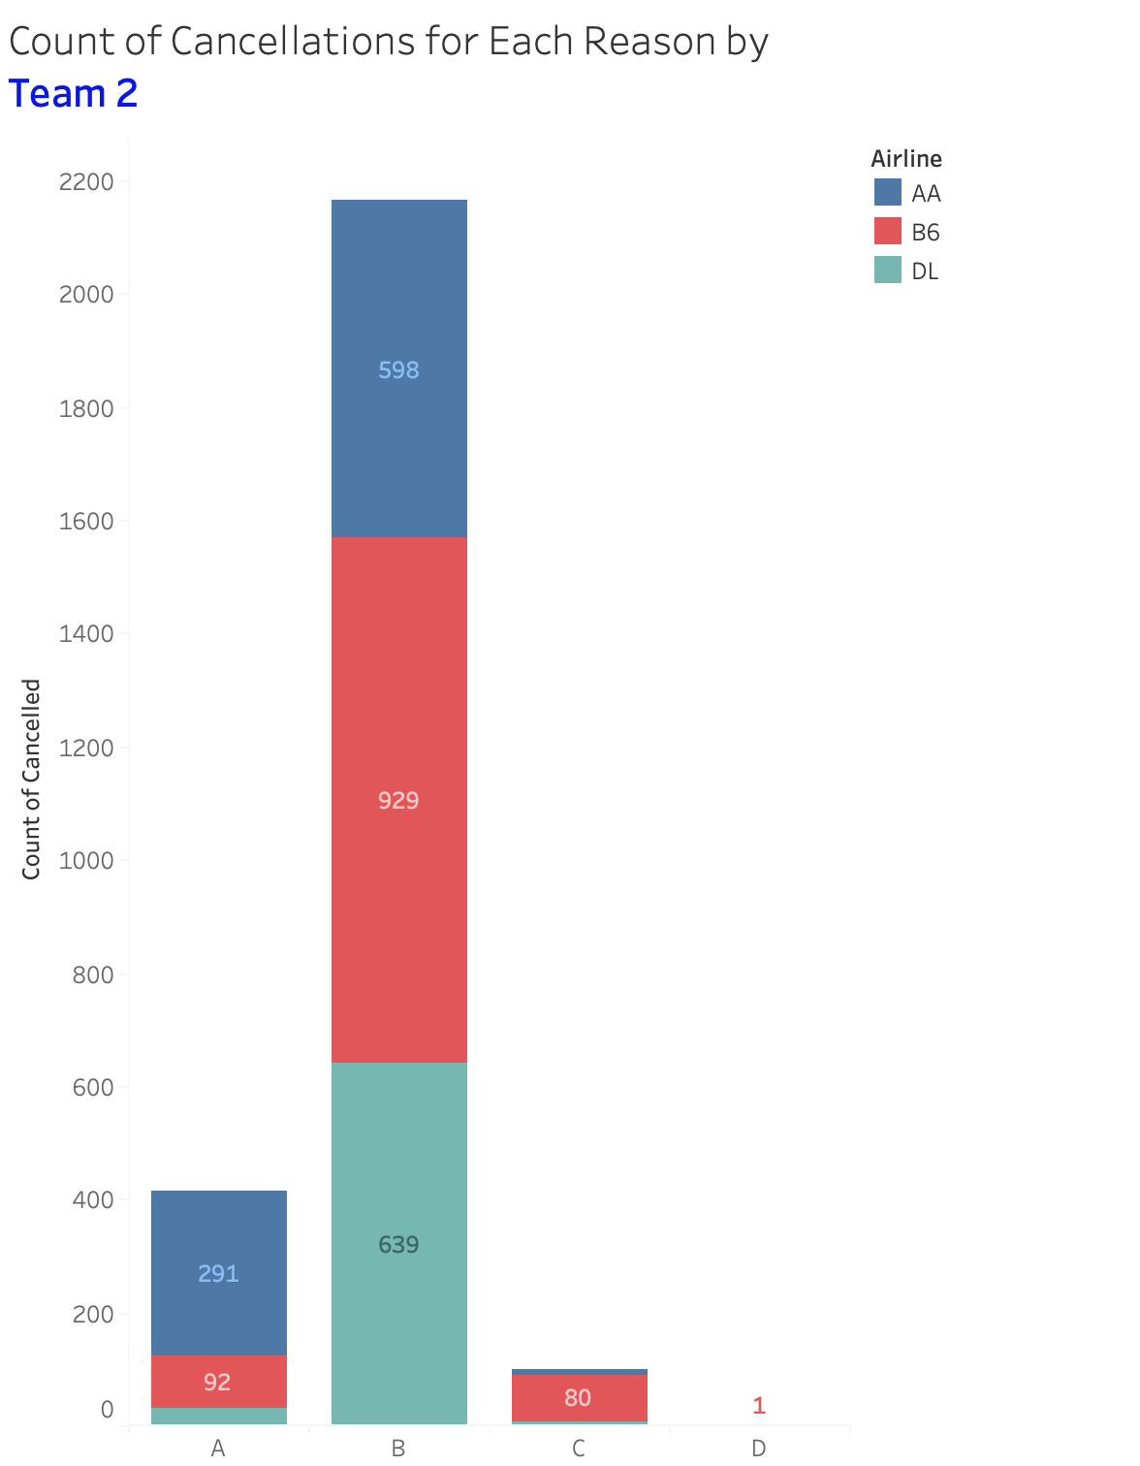
Chart 3: Number of Cancellations for Various Reasons:
Number of flight cancellations by each airlines for each individual reasons. Where,
Reason A: Airline Or Carrier
Reason B: Weather
Reason C: National Air System
Reason D: Security

Slide 10
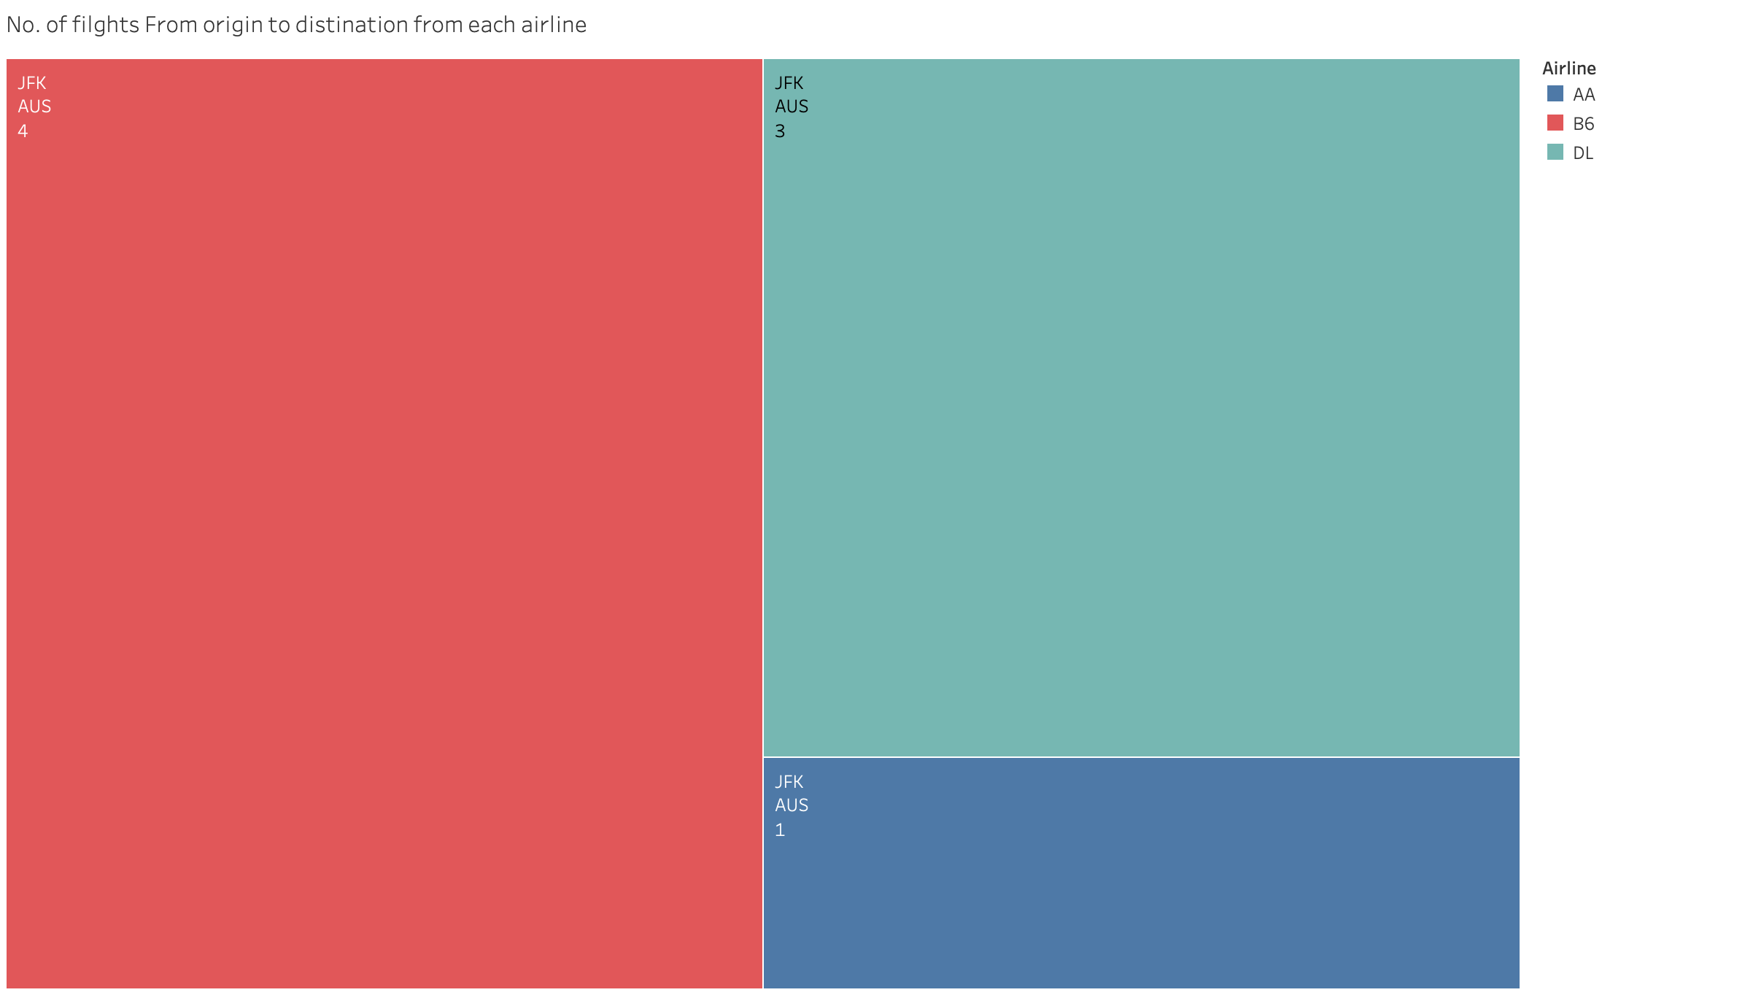
Chart 4: Number of flights by Airline:
Analysis: This chart provides insights into the number of flights operated by each airline from a given origin airport to its corresponding destination Airport.

Slide 11
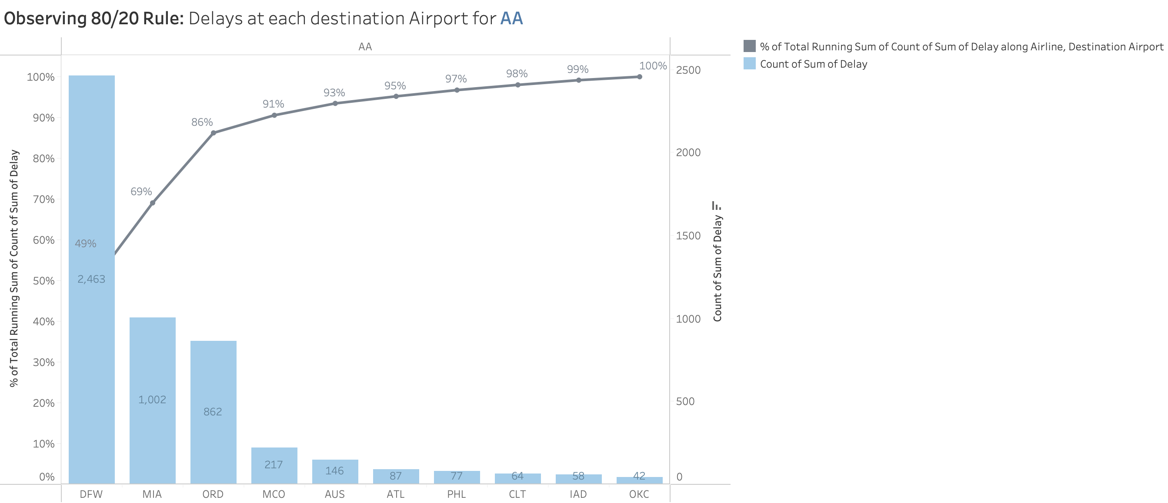
Chart 5: 80/20 Rule (Pareto Chart):
Analysis: 20% of airports (DFW, MIA, ORD) contribute to 80% of the delays experienced by American Airlines at its destination airports.

Slide 12
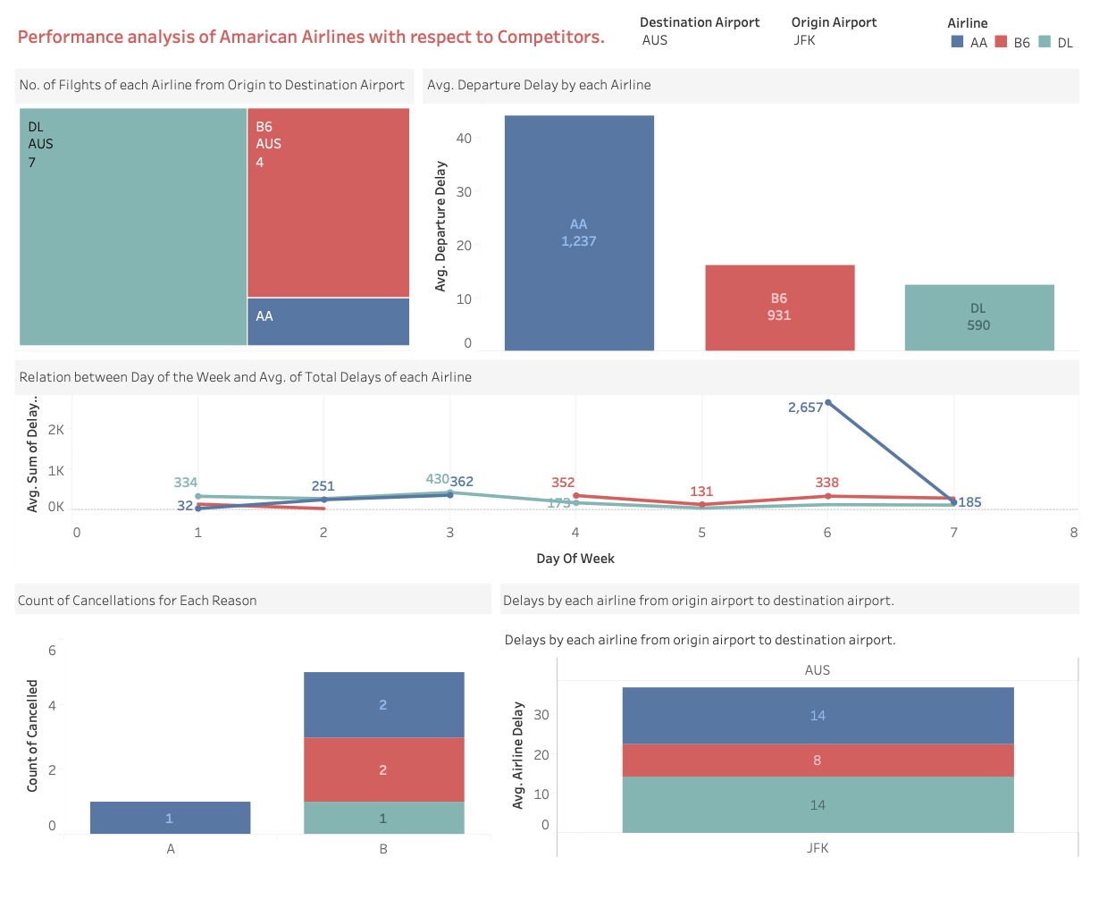
Dashboard:

Slide 13
Conclusion:
Analysis Summary:
Data-driven insights are pivotal in refining airline operations and elevating customer experience to new heights.
Comparative analysis of American Airlines, Jet Blue, and Delta Airlines reveals delay patterns, airport performance, departure/arrival delays, and air-time efficiency.
Insights empower American Airlines to optimize operations and enhance efficiency.
Leveraging data depth, American Airlines can implement targeted strategies to mitigate delays and improve passenger satisfaction.

Slide 14
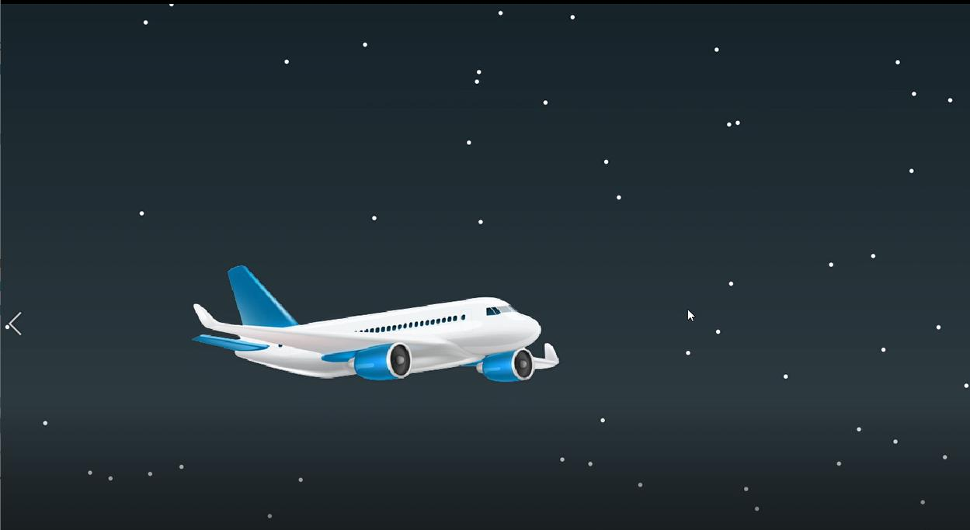

Questions?

Slide 15

Thank You:

